Slide 1
Hatfield Hall Information and Ticketing Android App
Ali Almajed
Caleb Drake
Andy Milluzzi
-Spring 2012-

Slide 2
The Problem
Do you know where seat D202 is?
Does seat R4 exist?
What is the next show?
What number do I call to reserve tickets?

Slide 3
Requirements
Simple UI
Seat finder with map of floor of Hatfield Hall
Venue contact information and map
List upcoming shows
Allow user to begin dialog with box office to order tickets
No changes to current Hatfield Hall website to get data

Slide 4
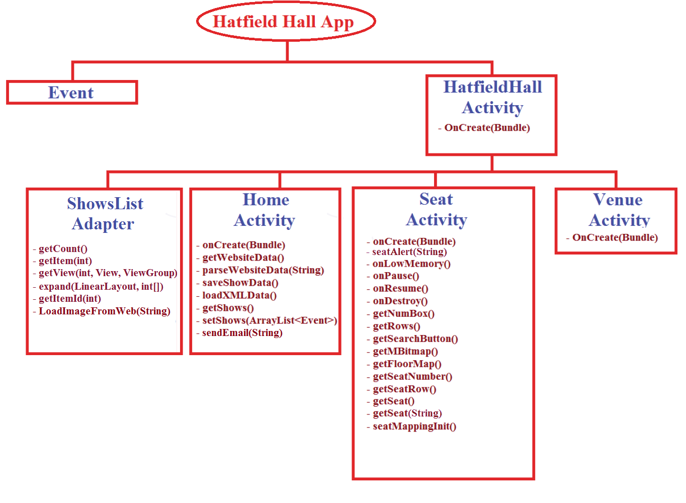
Class Design

Slide 5
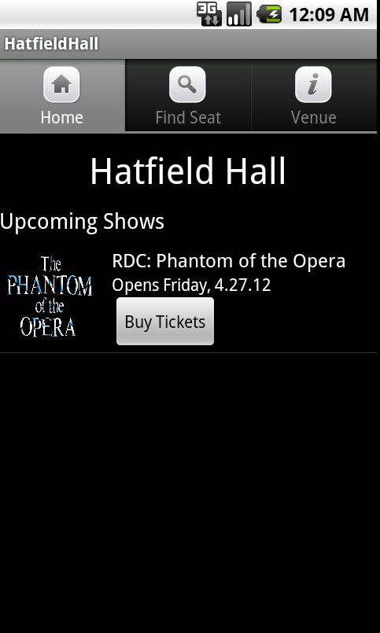
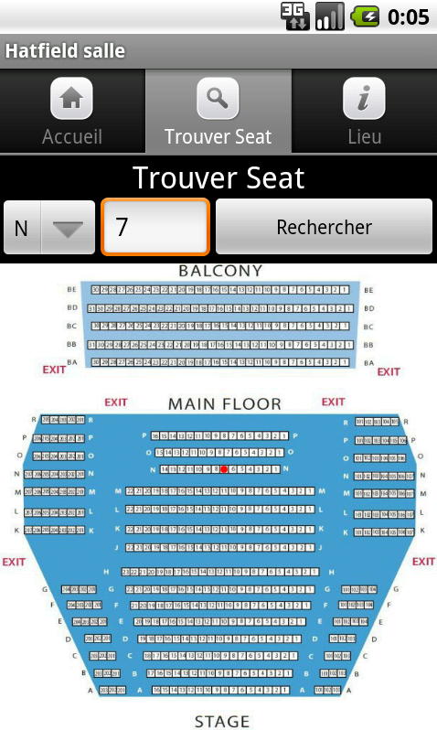
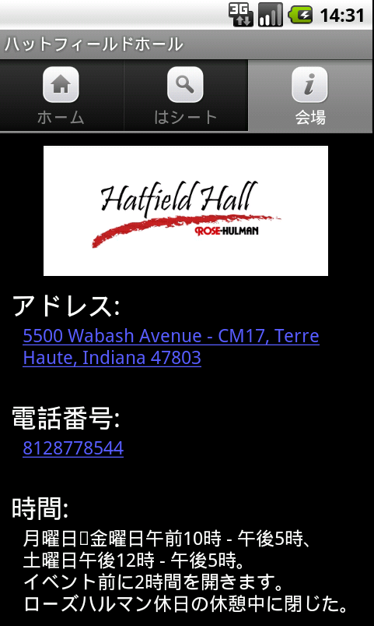
Laying-out a Design

Slide 6
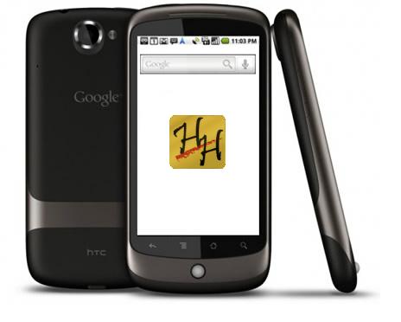
Demo!

Slide 7
Metrics
Method Complexity
Code Quality
Recovery Rate
Defect Rate
Test Thoroughness

Slide 8
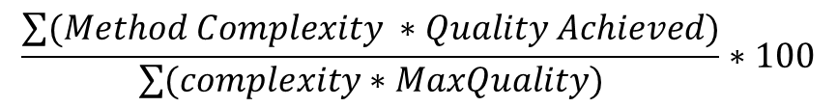
1- Methods Complexity.
2- Code Quality.
$$\frac{\sum{(Method Complexity ∗Quality Achieved)}}{\sum{(complexity∗MaxQuality)}}∗100$$

Slide 9
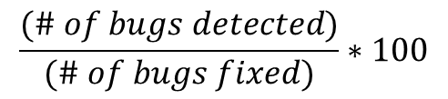
3- Recovery Rate
$$\frac{(\# of bugs detected)}{(\# of bugs fixed)}∗100$$
4- Defect Rate

Slide 10
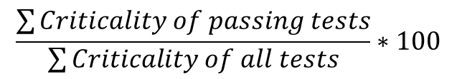
5- Test Thoroughness
$$\frac{\sum{Criticality of passing tests}}{\sum{Criticality of all tests}}∗100$$

Slide 11
Lessons Learned
Android has a really good unit testing framework
Sometimes you need to run tests on multiple sets of hardware
Very hard to unit test for things like an internet connection
Writing a test can often lead you to an idea on how to implement the methods
Would be really nice if possible to unit test UI (especially when it changes)

Slide 12
Questions

